Slide 1
REGRESSION OF USER MOVIE RATING -IMDb
Sai Teja Kanneganti
Sarvesh Prattipati

Slide 2
Project understanding
Data preparation
Modeling
Results

Slide 3
PROJECT UNDERSTANDING
Predicting movie rating and accessing key factors involved in rating a movie
The solution would be a number in the range 1 -10
The rating we see in the website is not the mean of the user ratings, but an undisclosed weighted average method involved in calculating the movie rating.

Slide 4
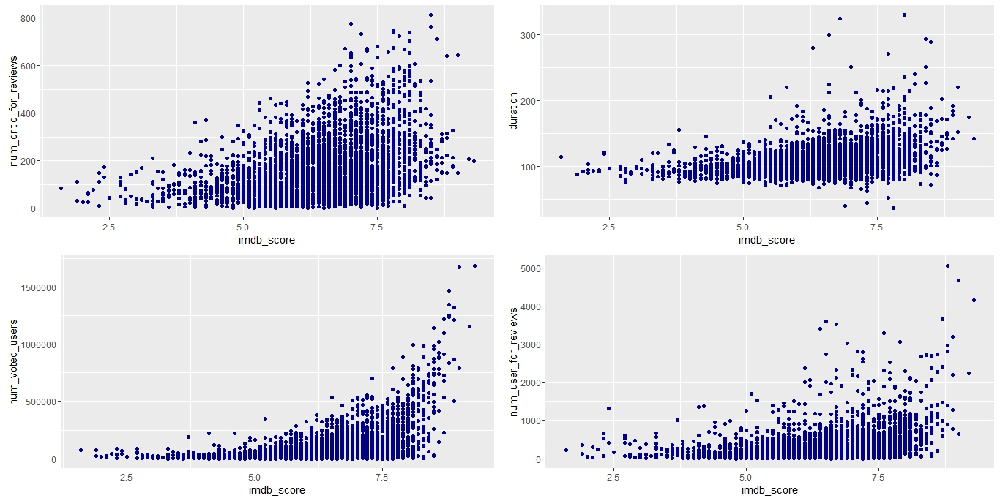
DATA PREPARATION
The dataset contains 5043 observations of 28 variables (16 numeric and 12 Categoric).

Slide 5
DATA PREPARATION (Contd.)
Missing names of cast and genre makes imputations difficult.
Budget of some foreign movies converted to USD.
Factor levels of up to 3000, complex to compute.
Face number in poster is treated for outliers where a poster has 43 faces

Slide 6
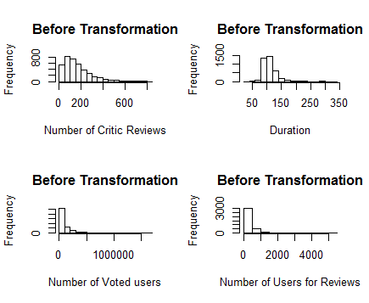
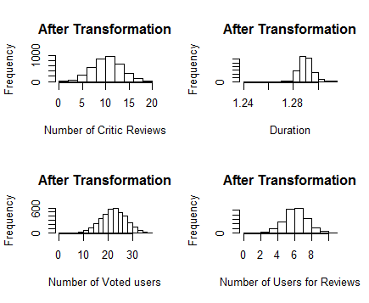
DATA PREPARATION (Contd.)
Skewed predictors are log transformed.
Feature selection using variable importance from random forest and decision trees.

Slide 7
MODELING
Approach
Analysing Algorithms
Model Selection
Trial and error
Repeated 10 fold CV
Elastic net
SVM
Rpart
Bagged cart
Random forest
GBM
kNN
Neural Net
RMSE
R squared

Slide 8
PRIMARY ANALYSIS
Random forest
RMSE: 0.6154
R squared: 0.651
Elastic net
RMSE: 0.7681
R squared: 0.4196
Gradient boosting method
RMSE: 0.6174
R squared: 0.6411
K nearest neighbors
RMSE: 0.7645
R squared: 0.4698
Bagged trees
RMSE: 0.7074
R squared: 0.5465
Support Vector machines
RMSE: 0.6741
R squared: 0.5988
rpart
RMSE: 0.8538
R squared: 0.3234
Neural network
RMSE: 0.7113
R squared: 0.5599

Slide 9
MODEL SELECTION

Slide 10
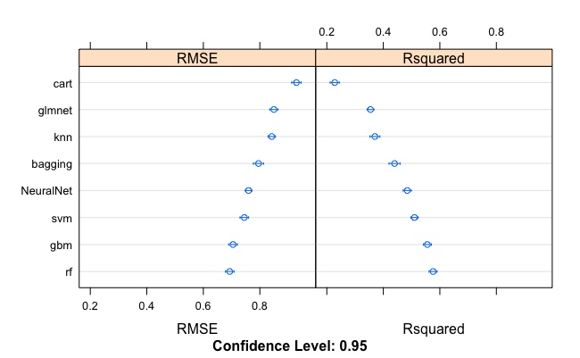
MODEL SELECTION(contd.)
Random forests
Gradient boosting method
Support Vector Machines
Place your screenshot here

Slide 11
ENSEMBLE METHOD – STACKING ALGORITHM
Model
Combiner
Random forest
Model 1
SVM
Model 2
GBM
Model 3
Train
Final Model

Slide 12
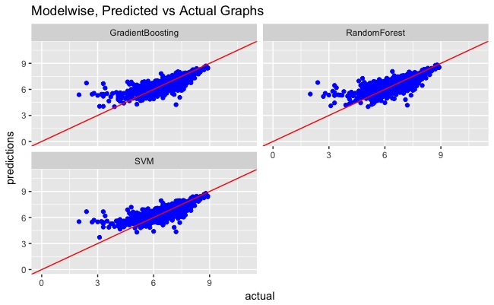
RESULTS
# Before stacked
#GBM = 0.7051026 0.5558759 (The final values used for the model were n.trees = 150, interaction.depth = 3, shrinkage = 0.1 and n.minobsinnode = 10)
#RF = 0.6933121 0.5759998 (mtry=8)
#SVM = 0.7450903 0.5102352 (sigma = 0.1545986 and C = 1)
# After Stacked Algorithm
GBM = 0.6741655 0.5926593
RF = 0.6858708 0.5799645
SVM = 0.6757145 0.5932901(sigma = 1.393034 and C =1)
# Predicted Values RMSE
GBM = 0.6997279
RF = 0.7359729
SVM = 0.7087499

Slide 13
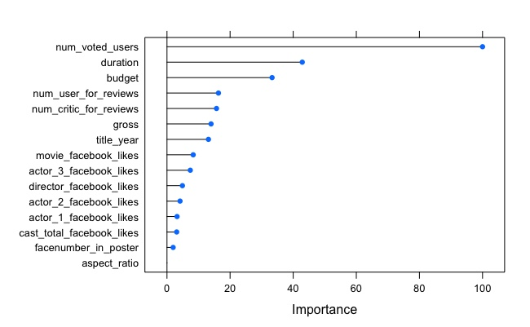

VARIABLE IMPORTANCE
The top 5 important variables from Random Forest, SVM and Gradient Boosting that influence the rating are:
Number of Voted users
Budget
Number of Critics for review
Number of users for review
Duration

